Slide 1
Venue analysis for a new Italian restaurant in Brooklyn

Slide 2
Finding a neighborhood best suited for new business
Choosing a neighborhood for starting a new restaurant can be a tedious task as it involves a lot of money.
Data might contribute in determining a suitable place.
Analyzing every aspect such as the population of an area, top venues liked and often visited by people in a neighborhood can be really helpful.
This model can be used by other investors too who are new to an area and want to analyze first before investing.

Slide 3
Data description
Borough, Neighborhood, Latitude and Longitude values of New York from https://geo.nyu.edu/catalog/nyu_2451_34572. Data was reduced to that of Brooklyn.
Brooklyn current population statistics from https://www.worldatlas.com/articles/brooklyn-neighborhoods-by-population.html
Foursquare API, Geopy and Folium were used.

Slide 4
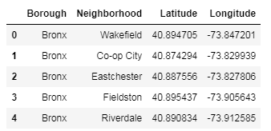
The master dataframe
We have all the Boroughs, their Neighborhoods and their latitudes and longitudes. But we require a subset of this dataframe that is only for the Borough of Brooklyn.

Slide 5
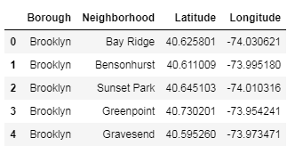
Creating a dataframe for all the neighborhoods of Brooklyn

Slide 6
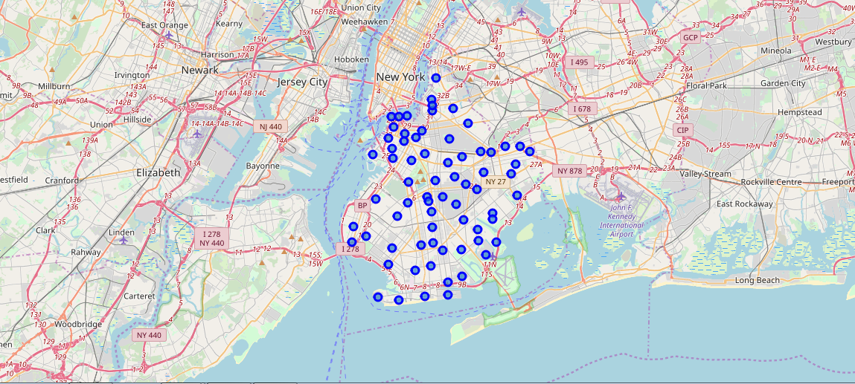
Visualizing the neighborhoods of brooklyn
Folium is being used to create a map which visualizes all the neighborhoods of Brooklyn. Geopy is being used to get the location.

Slide 7
Finding the most populated neighborhood in brooklyn
Though there are many challenges and many factors to be considered, if an area is highly populated, it means that there is less risk in starting a new restaurant. Businessmen usually prefer prime locations to start such ventures.
There are 36 Neighborhoods in Brooklyn.
I used a dataset to determine the most populated areas.

Slide 8
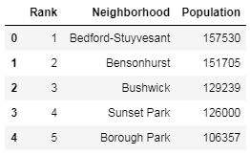
Selecting the top 2 from this dataframe
Bensonhurst and Bedford Stuyvesant are the 2 most populated neighborhoods with many venues around them.

Slide 9
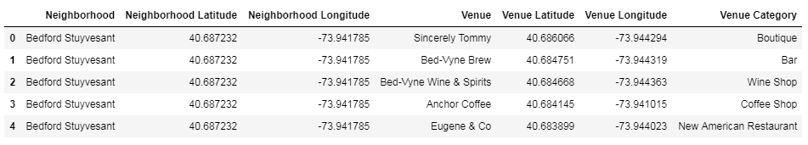
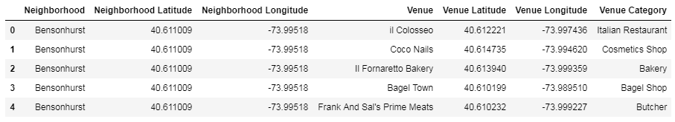
Finding the venues in both the areas
Foursquare lab functions are being used for determining the venues and their category for both the neighborhoods.

Slide 10
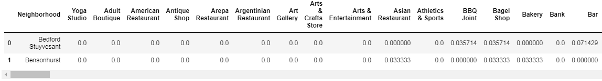
Finding the frequency of all kind of venues
Frequency of existence of all kind of venues in the neighborhoods so that we could know more about the competitions.

Slide 11
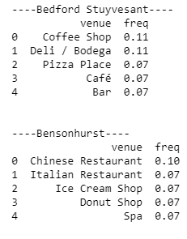
Finding the frequency of the top 5 venues
For both the locations:

Slide 12
TOP 5 most common venues in both the neighborhoods

Slide 13
Result and conclusion
There is already a famous and favorite Italian Restaurant in Bensonhurst and it stands 3rd in the Most Common Venues.
There are no special cuisine restaurants in the top most common venues for Bedford-Stuyvesant. So, it is a better option than Bensonhurst for starting a new Italian Restaurant.
However, we can also notice that there is a Pizza Place which is often visited by the people in the neighborhood which tells us that people are interested in Italian cuisine.
As a result, Bedford Stuyvesant is the neighborhood in Brooklyn which the investor should choose to go on with the proposal of starting a new Italian Restaurant.

